Slide 1



Where/who app

Slide 2

Our mission:
Our mission:
bringing people together
When help is needed people
▶
don‘t know who to look for
Teams don’t know what other
▶
teams are working on
In-company innovation
▶
Business value:
Business value:
save time = save money

Slide 3

The product:
The product:
Where/who application

Slide 4
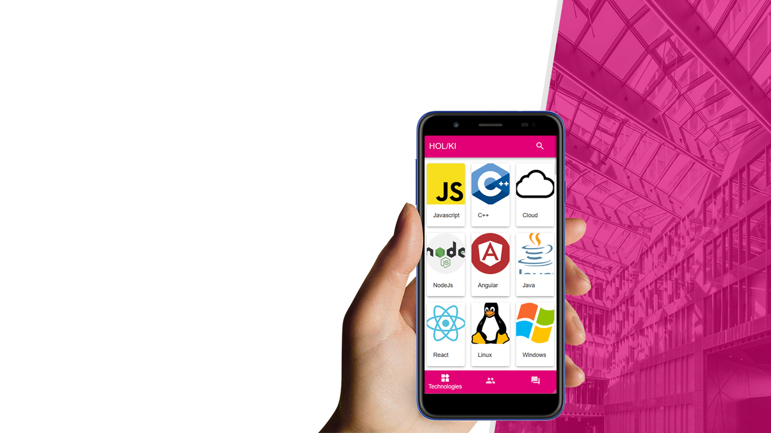
The product:
The product:
Where/who application
Find the person who can help you out
▶

Slide 5
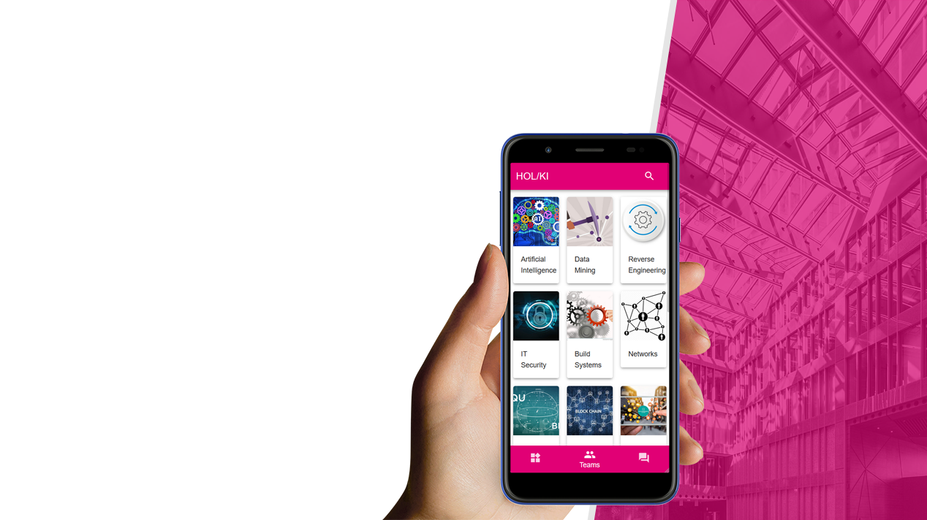
The product:
The product:
Where/who application
Find the person who can help you out
▶
Sort by skills or projects
▶

Slide 6
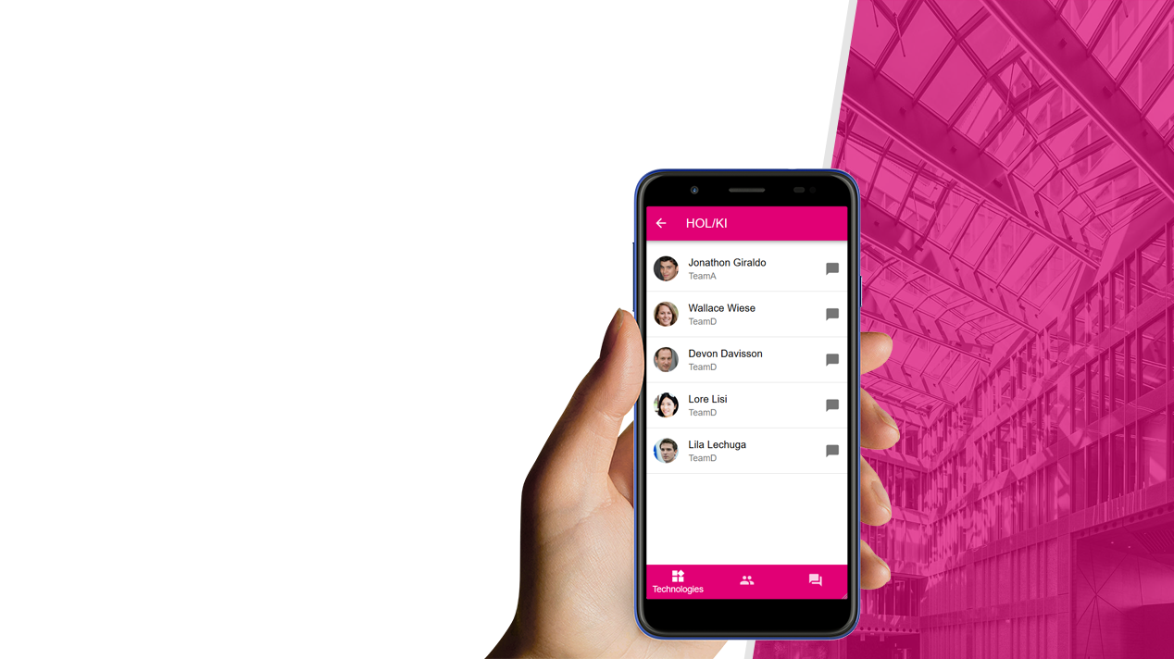
The product:
The product:
Where/who application
Find the person who can help you out
▶
Sort by skills or projects
Availibility check
▶

Slide 7

The product:
The product:
Where/who application
Find the person who can help you out
▶
Sort by skills or projects
Availibility check
Instant messages
▶

Slide 8

The product:
The product:
Where/who application
Find the person who can help you out
▶
Sort by skills or projects
Availibility check
Instant messages
Ask your questions on the forum
▶

Slide 9
The product:
The product:
Where/who application
Find the person who can help you out
▶
Sort by skills or projects
Availibility check
Instant messages
Ask your questions on the forum
Technical details
▶
Easily accessible
▶
Chance to say „Thank You!”
▶
Feedbacks are considered in sorting, but are only viewable for the receiver
▶

Slide 10
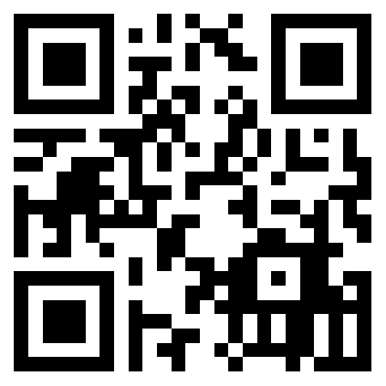


Thank You!
See the website
for yourself!

